Slide 1
Status and Plans for LARP Eric Prebys (outgoing) LARP Director

Slide 2
LARP History
The US LHC Accelerator Research Program (LARP) was formed in 2003 to coordinate US R&D related to the LHC accelerator and injector chain at Fermilab, Brookhaven, and Berkeley
SLAC joined shortly thereafter
Has also had some involvement with Jefferson Lab, Old Dominion University and UT Austin
LARP has contributed to the initial operation of the LHC, but much of the program is focused on future upgrades.
The program is currently funded at a level of about $12-13M/year, divided among.
Accelerator research
Magnet research (~half of program)
Programmatic activities, including support for personnel at CERN

Slide 3
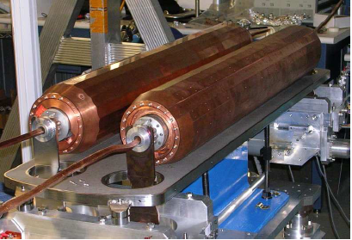
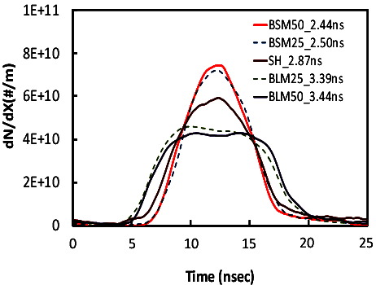
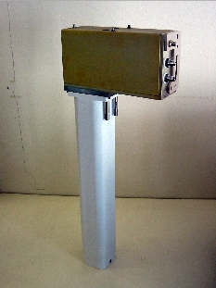
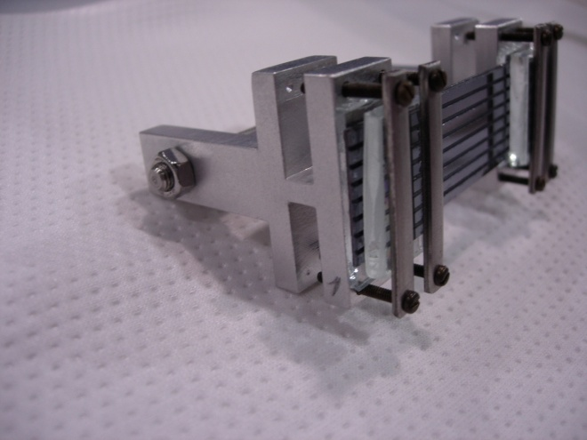
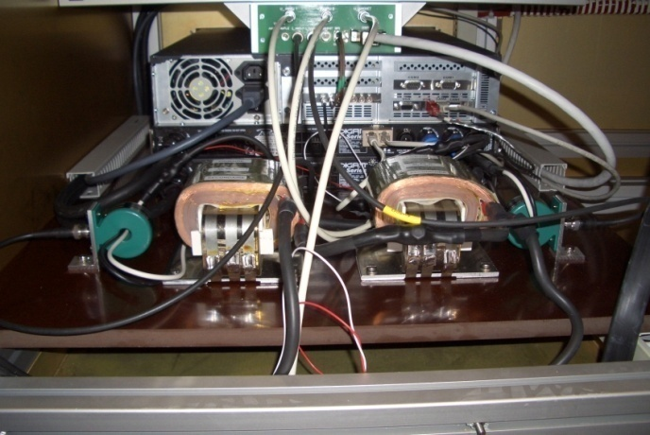
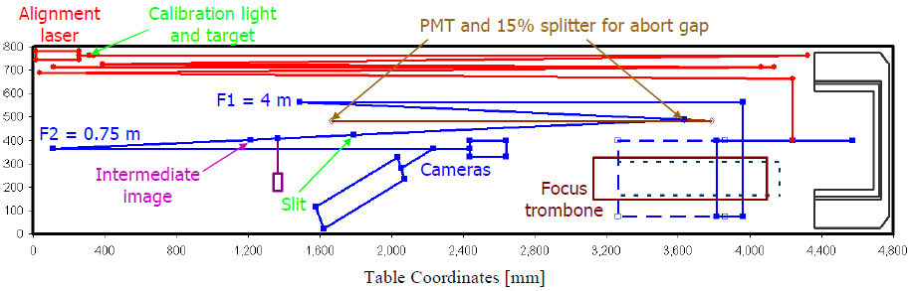
Some (random) LARP Activities
Flat Bunches
Luminosity Monitor
Rotatable Collimators
Crystal Channeling
Instability Modeling
AC Dipole
Personnel support (to date):
11 Toohig Fellows
Postdoctoral Fellows who divide time between CERN and LARP host lab
8 Long term visitors
Senior personnel spending between 6 months and two years at CERN.
Sync. Light Monitor

Slide 4
Impact of LARP Personnel Programs
Letter to Michael Procario, Acting Head, DOE Office of High Energy Physics, 9-MARCH-2011
(…)

Slide 5
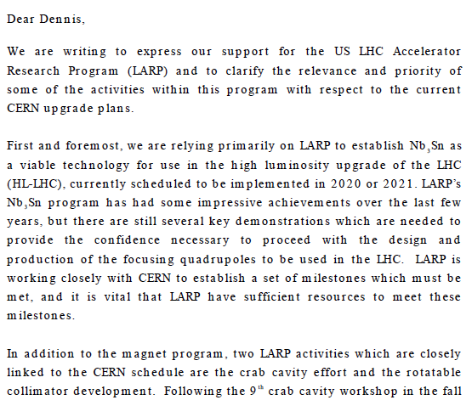
Relevance of LARP to CERN Upgrade*
Letter to Dennis Kovar, Head, DOE Office of High Energy Physics, 17-August-2010
(…)

Slide 6
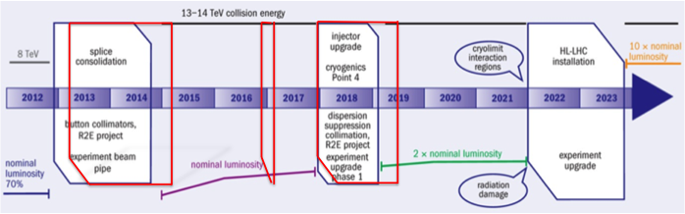
Context: LHC Upgrade Path
Time Line:
LS1*: “Nominal” (2013-2014)
Complete repairs of the superconducting joint and pressure relief problems which cause “the incident” in 2008 and currently limit the energy to 4+4 TeV.
“Lost memory” issues may limit the beam energy to somewhere between 6.5 and 7 TeV per beam.
At least 1x10³⁴ cm⁻²s⁻¹ peak luminosity
LS2: “Ultimate” (2017)
injector and collimation upgrades
At least 2x10³⁴ cm⁻²s⁻¹ peak luminosity
LS3: “HL-LHC” (~2022-2023)
Lower β* and compensate for crossing angle to maximize luminosity
5x10³⁴ cm⁻²s⁻¹ leveled luminosity
*LS = “Long Shutdown”

Slide 7
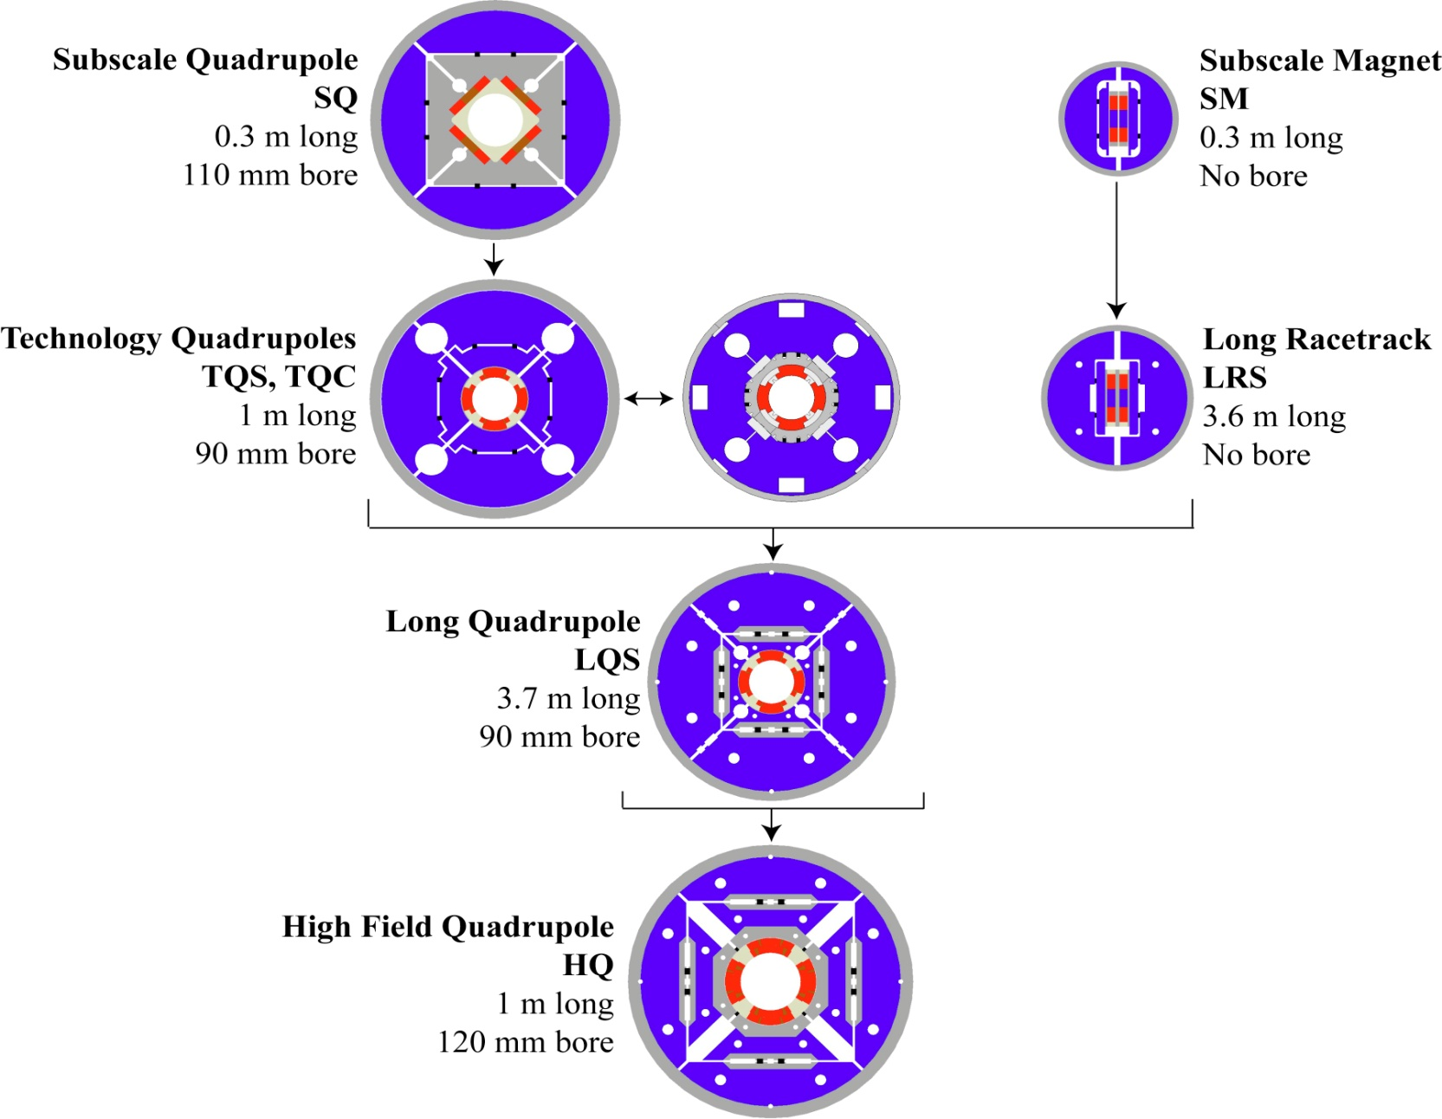
LARP Magnet Development Tree
Completed
Length scale-up
Achieved
220 T/m
High field
Accelerator features
Being tested

Slide 8
Recent Success!
120 mm aperture x 1 m HQ reached 170 T/m at FNAL
It was agreed with CERN that this would establish Nb₃Sn as a viable technology for the LHC upgrade
Next step is a real prototype.
Press release coming soon.

Slide 9
➔New Direction for LARP
LARP has historically been an R&D organization
Not well structured for hard deliverables
CERN upgrade plans in a state of flux
Recent developments
CERN has formalized the planning for the luminosity upgrade
In June 2012, CERN chose 150 mm as the aperture for the final focus quads
At the DOE’s request, we are in the process of transforming LARP into a project to encompass all US contributions to the luminosity upgrade of the LHC.
Budget Guidance
Flat-Flat LARP funding @ ~$12.4M/year through FY16
A total of $200M (then year dollars) TPC, assuming CD-3 at approximately the beginning of FY17
“Some amount” of General Accelerator Research and Development (GARD) funds invested in support of this program.

Slide 10
Candidate Deliverables Considered
Traditional LARP Scope
150 mm aperture Nb₃Sn quadrupoles
Likely just cold masses, divided between here and CERN
Crab Cavities
Prototypes. Production Units. Cryomodules.
High Bandwidth Feedback System
Pick-ups. Processing Systems. Response Kickers.
Collimation
Rotatable collimators.
Hollow electron beams.
New Scope
11 T Nb₃Sn dipoles
Used to make room for collimation in dispersion suppression region
Has been a bilateral CERN/FNAL effort
Large Aperture NbTi D2 separator magnets
First dual aperture magnets near Irs
Has been bilateral CERN/BNL effort

Slide 11
Proposed Deliverables
A consensus quickly emerged among scope selection committee (CERN, DOE, LARP labs) regarding priority
Core deliverables
Magnets:
US will deliver half of Nb₃Sn cold masses for final focus magnets at ATLAS and CMS IPs
CERN will collaborate on the prototype and proved the other half of the cold masses, as well as cryostats and all infrastructure.
Crab cavities:
US will produce cavities to test in the SPS in 2016
US will build crab cavities and cryomodules for luminosity upgrade.
CERN will provide power couplers, power supplies, cryo, and infrastructure.
Feedback:
US will provide algorithms, processing hardware/firmware, and RF components for a functioning feedback system in the SPS.
CERN will provide vacuum components (pickups and kickers).

Slide 12
Status and Plans
We presented the rough plan to the DOE in February, 2013
Generally supportive of proposed deliverables and required funding profile.
Moved forward with planning
Internal review of deliverables in June 2013,
Positive about projects and level of planning
Some concern about early funding requirements for crab cavities
Currently revising management structure more appropriate to a large project with hard deliverables.
Giorgio Apollinari chosen as new LARP Director!

Slide 13
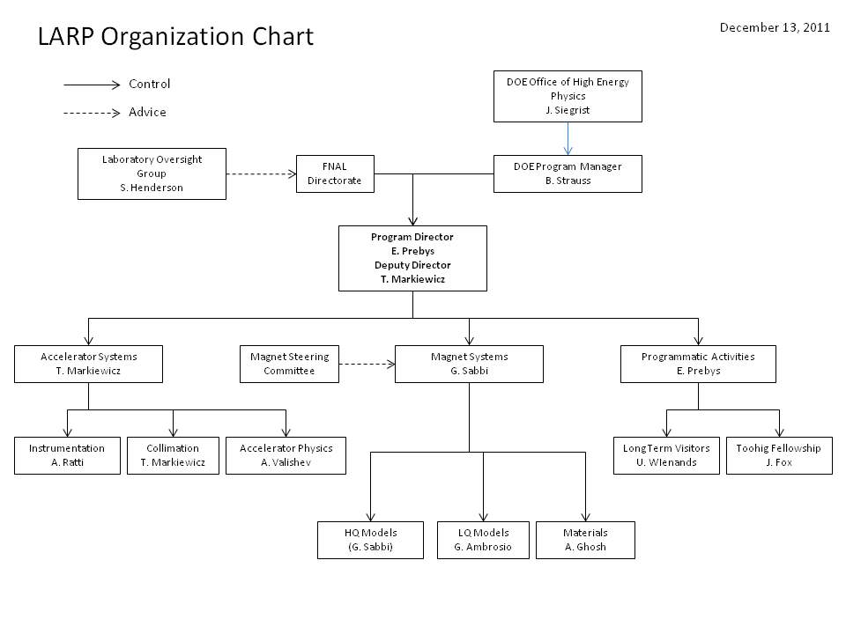
Traditional LARP Structure

Slide 14
Proposed New Structure
Traditional LARP

Slide 15
Conclusion
LARP has been extremely successful at leveraging US capabilities to develop technology for the LHC.
We are in the process of transforming the program into a production effort to produce significant hard deliverables for the LHC luminosity upgrade.
Big thanks for all the hard work from all of the people involved and for the support of our collaborators at CERN!

Slide 16
BACKUP Material

Slide 17
LARP Contributions to Current LHC Operation
Schottky detector
Used for non-perturbative tune measurements (+chromaticities, momentum spread and transverse emmitances) – Operational (currently some issues)
Tune tracking
Implement a PLL with pick-ups and quads to lock LHC tune – Fully integrated
Investigating generalization to chromaticity tracking
AC dipole
US AC dipole to drive beam
Measure both linear and non-linear beam optics – Primary tool for high energy optics
Luminosity monitor
High radiation ionization detector integrated with the LHC neutral beam absorber (TAN) at IP 1 and 5. – Functional, becoming primary fast system.
Synchrotron Light Monitor
Used to passively measure transverse beam size and monitor abort gap
Not a LARP project, but significantly improved by LARP – Operational (currently some issues)
Low level RF tools
Leverage SLAC expertise for in situ characterization of RF cavities – Fully integrated
Personnel Programs
Toohig postdoctoral fellowship
Long Term Visitor Program

Slide 18
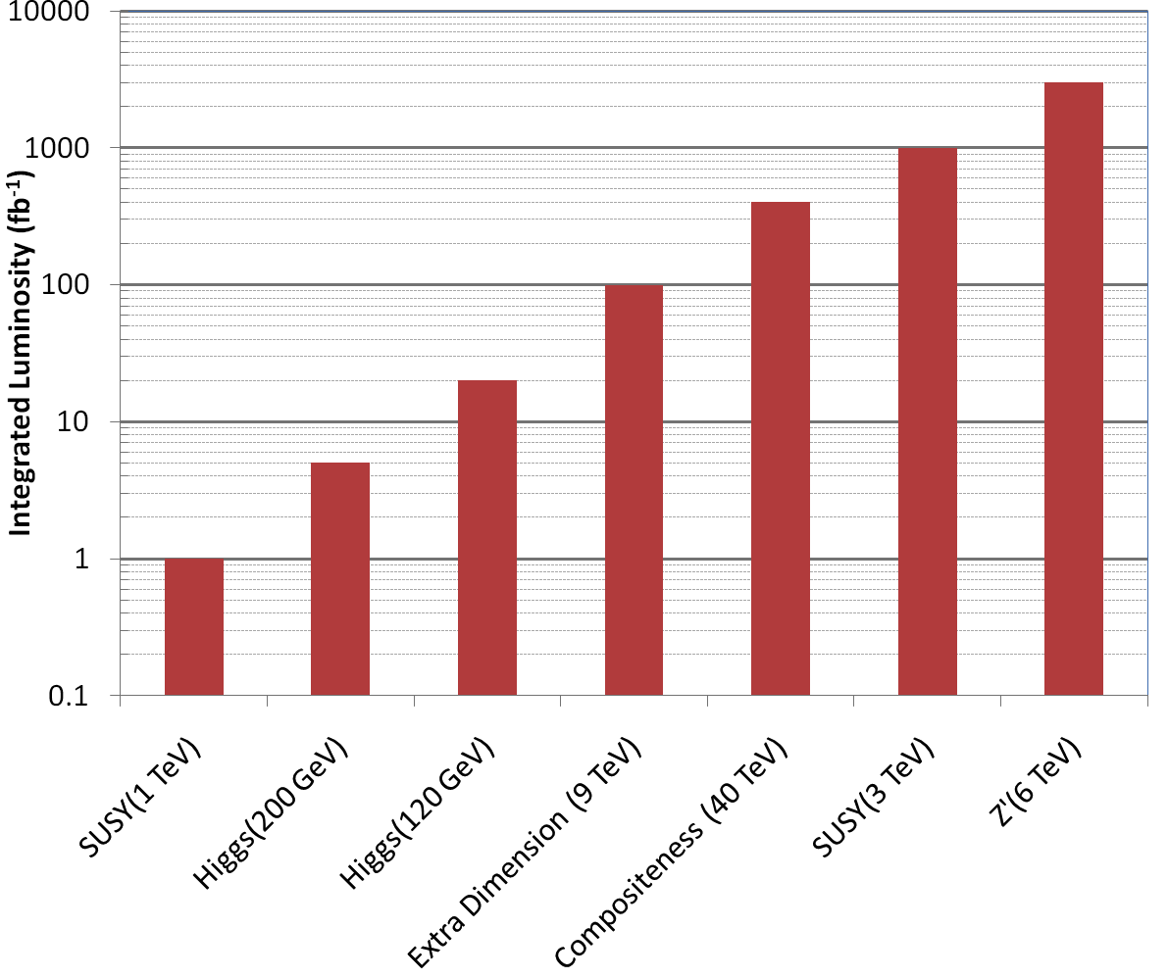
Motivation: The Big Picture
3000 fb⁻¹
~ 50 years at nominal LHC luminosity!
The future begins now

Slide 19
HiLumi-LHC Design Study
The Luminosity upgrade planning will be largely organized through EU,
Centrally managed from CERN (Lucio Rossi and Oliver Bruning)
Non-CERN funds provided by EU
Non-EU partners (KEK, LARP, etc) will be coordinated by HiLumi-LHC, but receive no money.
Work Packages:
WP1: Management
WP2: Beam Physics and Layout
WP3: Magnet Design
WP4: Crab Cavity Design
WP5: Collimation and Beam Losses
WP6: Machine Protection
WP7: Machine/Experiment Interface
WP8: Environment & Safety
LARP is now integrating most of its activities into this framework
Two LARP meetings/year ➔two joint meetings/year (spring in US, fall in Europe)
Goal
CDR: 2014
TDR: 2015
Significant LARP and other US Involvement

Slide 20
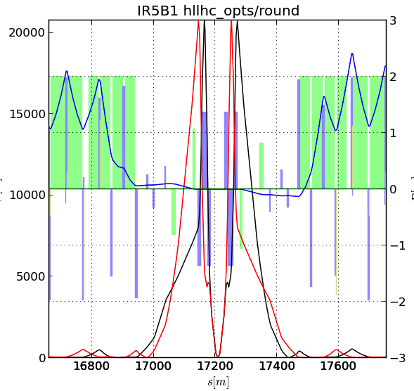
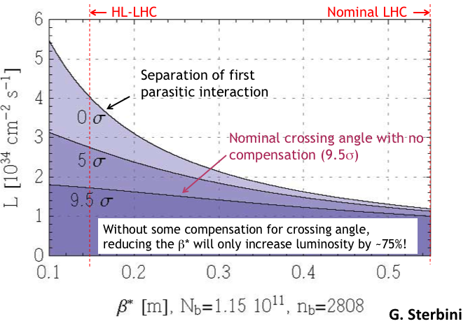
Key Components of HL-LHC
Reduce β* from 55 cm to 15 cm
Requires large aperture final focus quads
Beyond NbTi without making the quads unmanageably long.
➔Requires Nb₃Sn
never before used in an accelerator!
Nb3Sn R&D key component of LARP
BUT, reducing β* increases the effect of crossing angle
“Piwinski Angle”

Slide 21
(Rough) Budget Assumptions
“Traditional” LARP funding
Flat-flat @ $12.4M/year through FY16
$9.4M for these projects and related management
=$37.6M
$3M for continuing R&D which is not included here
Project Funding
$200M
Nominally starting in FY17
Some funds available for procurement and infrastructure as early as FY15
Significant GARD and CERN contributions will not be represented by specific dollar amounts at this point, but rather as assumptions about what will be contributed from outside the project and therefore will not appear in our budget
Clearly, this will have to be formalized at some point

Slide 22
The Process
Committee formed consisting of
LARP Management
Eric Prebys, FNAL
Tom Markiewicz, SLAC GianLuca Sabbi, LBNL
Peter Wanderer, BNL
CERN HL-
Lucio Rossi, CERN
Oliver Brüning, CERN
DOE
Bruce Strauss, DOE
Labs
Represented by Stuart Henderson, FNAL
Project support
Marc Kaducak, FNAL
Met several times over several weeks, including at the fall meeting in Frascati

Slide 23
Feedback from CERN
Top Priority
Backup

Slide 24
Proposed Magnet Contribution
In June, 2012, the choice was made of 150 mm as the aperture for the focusing quads in the LHC upgrade.
LARP activities have been modified in accordance with this decision and recommendations of our July 2012 review
Curtail existing 120 mm program
Work with CERN to develop a 150 mm prototype (LQXF)
The program will then full transition into a production project to produce the focusing quadrupoles for the LHC upgrade
US contribution
Cold masses for the Q1 and Q3 quads, to be cryostated at CERN
A total of 20 half length (4 m) cold masses, including 2 pre-series units, 16 production units, and 2 spares

Slide 25
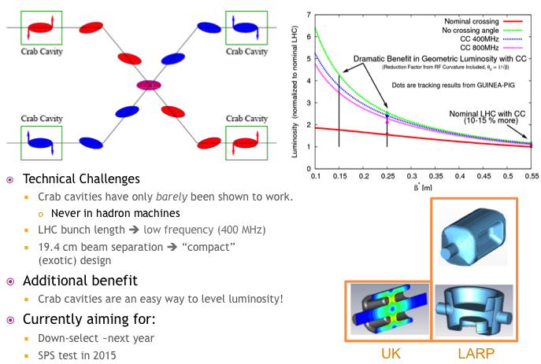
Crab Cavity Development

Slide 26
Proposed Crab Cavity Contribution
LARP has been a major proponent of crab cavities since the beginning
Currently two of the three candidate designs are from within LARP
Crab cavities leverage US expertise and US industry
All prototypes, including the UK prototype, have been built in the US.
Proposal
The LARP R&D program will continue work on the two cavity designs:
RF-Dipole
Double Quarter Wave
Efforts will increase at FNAL on cryostat design
This will culminate with the delivery of a test cryostat with cavities of one of the designs for a beam test in the SPS (2015 or 2016)
The project will undertake the production of 10 cryomodules (4 per IP + 2 spares) for installation in the LHC upgrade
CERN will provide RF couplers and all required infrastructure

Slide 27
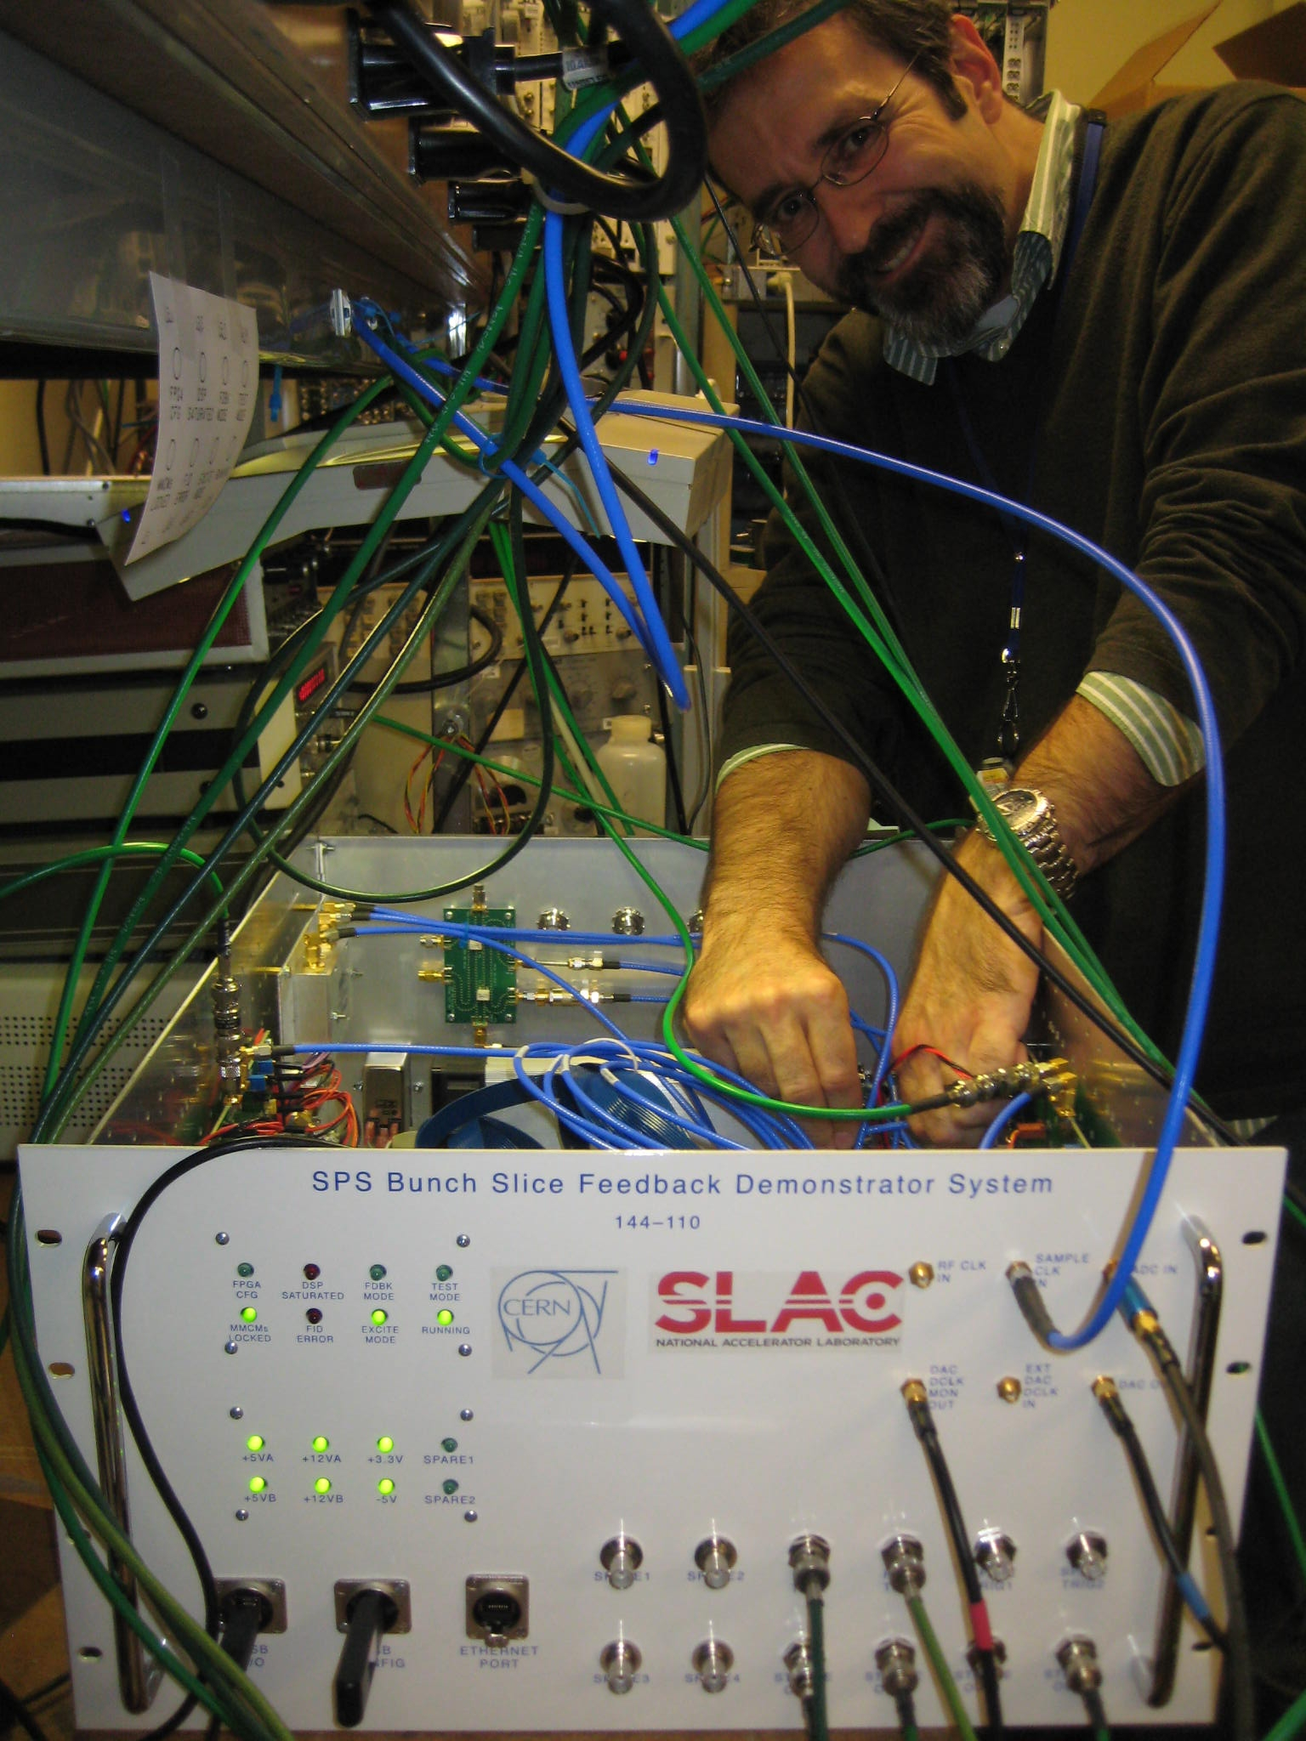
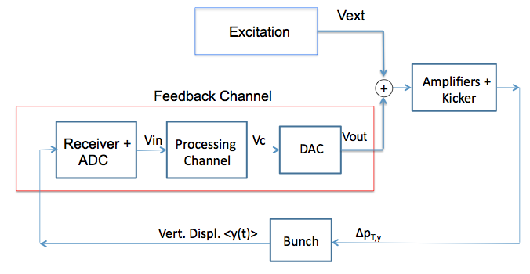
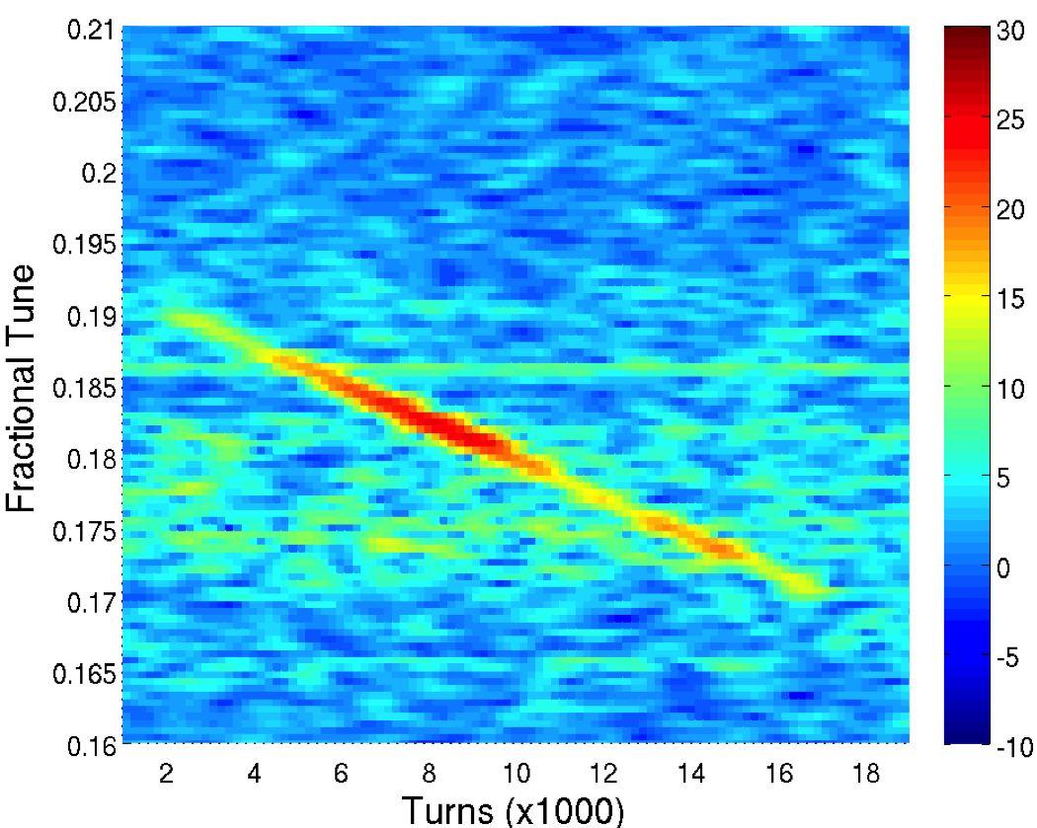
Feedback System

Slide 28
High Bandwidth Feedback System
The high bandwidth feedback system is a proposed feedback system for the SPS, which leverages LARP experience with the LHC LLRF system
Proposal
LARP will continue R&D related to the system.
The deliverable would be a functional feedback system the SPS, for which
The US contribution would be the complete, full-function, instability control system hardware, firmware and software necessary to operate at the SPS (and potentially LHC, PS).
The CERN contribution will include the vacuum structures (pickup(s) and kicker(s)) and all tunnel related cable plant.

